Slide 1
CRM
Customer Relationship Management

Slide 2
Definition of terms
Registered User
-These are registered user who sign up in our website with themselves.
Pre-registered User
-These are registered user who are registered by the CES for information purposes.

Slide 3
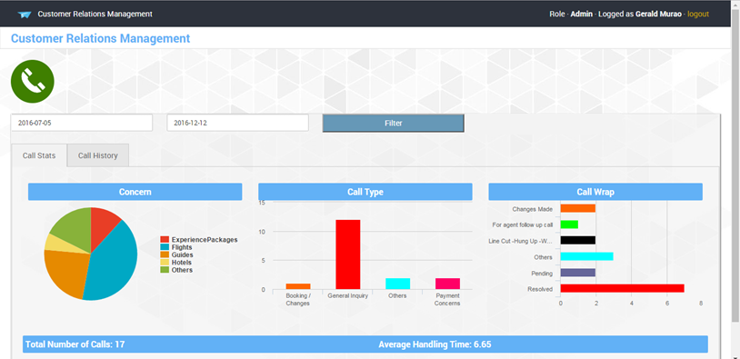
Dashboard
Call stats tab
shows 3 graphs that are classified into concern of the caller, call type and call wrap. It also shows the total number of calls on the filtered date and its average handling time.
Note:
It can be filtered by dates. This is per CES only. They can’t be view the call transaction of other CES.
Pie Graph is clickable in order to categorized the call type and call wrap into concern(e.g. Flights, Hotels, Experience packages and etc. )

Slide 4
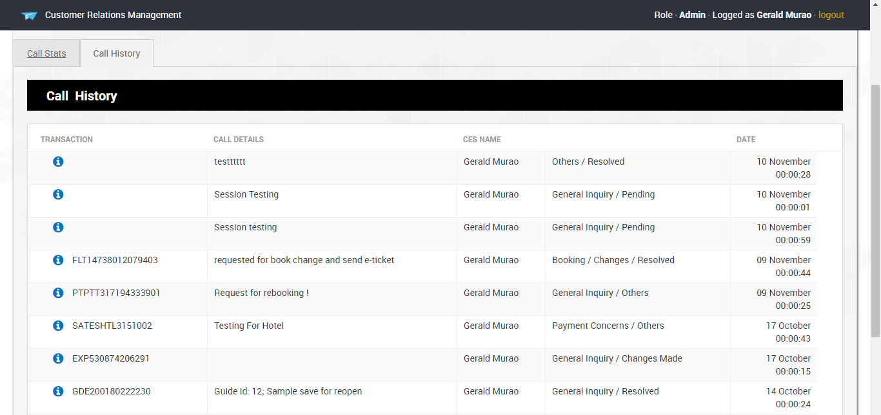
Dashboard
Call History Tab
The data shown here are the transactions being shown by the graph of Call stats. It is also filtered between the dates selected.

Slide 5
Dashboard
Call Button
Click this button when there is a customer calling. This button will let the CES to go the form of CRM in order to select and type the information during the call session

Slide 6
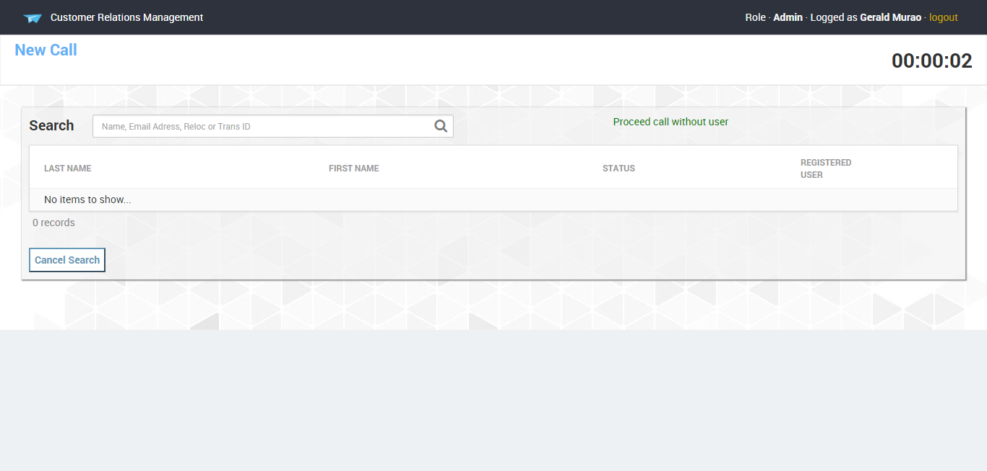
Call
Call
In this web screen, CES will be able to search for the customer who booked and are registered/pre-registered on the tripmoba website. The CES will be able to search for name, email, code locator or transaction id.

Slide 7
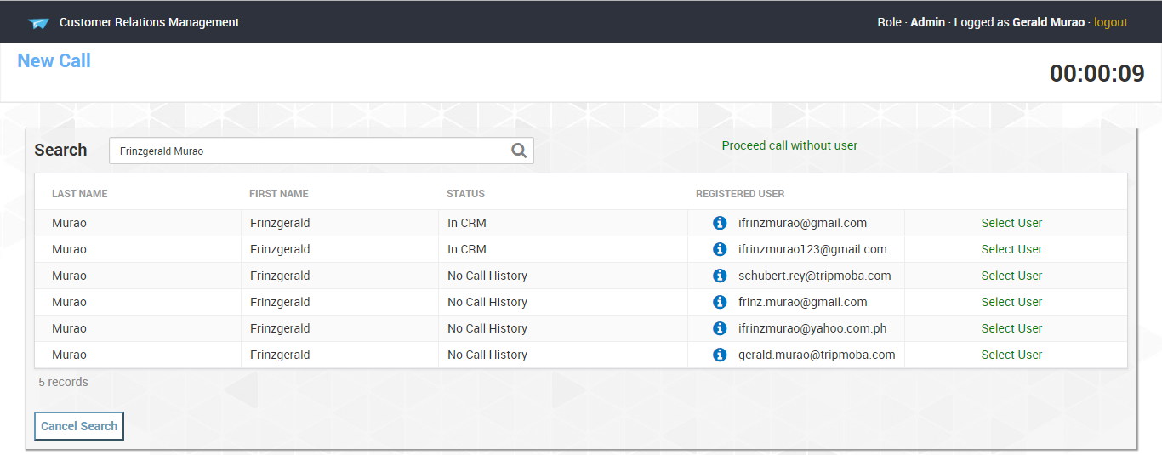
Call
Proceed call without user
This link will be clicked, if there is no user found on the table or if the caller is not registered/pre-registered on our website.
Cancel Search
To cancel the call, click this button.

Slide 8
Call
Select User
This link exists when the email used is register/pre-register in our tripmoba site.
This link help the CES to select, who is the caller or customer on the line.

Slide 9
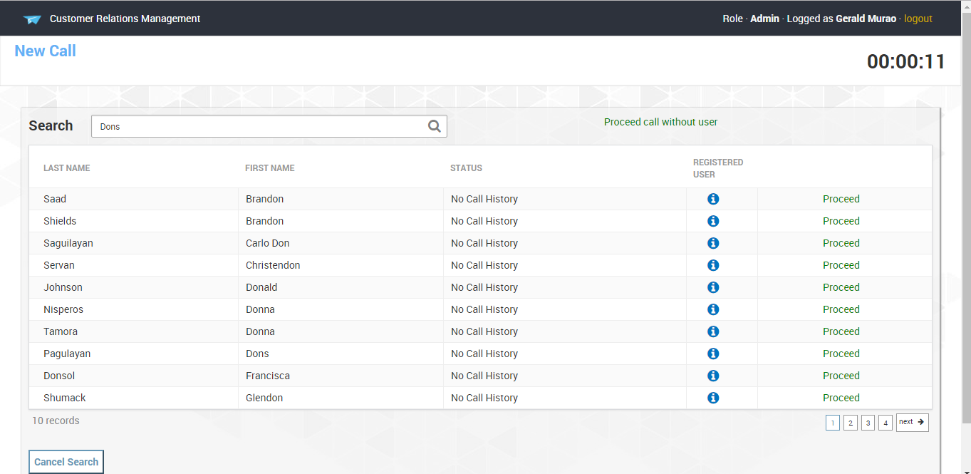
Call
Proceed
This link exists when the email used in booking to our site is not yet registered/pre-registered to our tripmoba site.
This link also helps the CES to select who is the customer calling.
Note:
If the CES search for the Transaction Id or Code locator the table will display the passenger/s on that specific Transaction Id or Code Locator

Slide 10
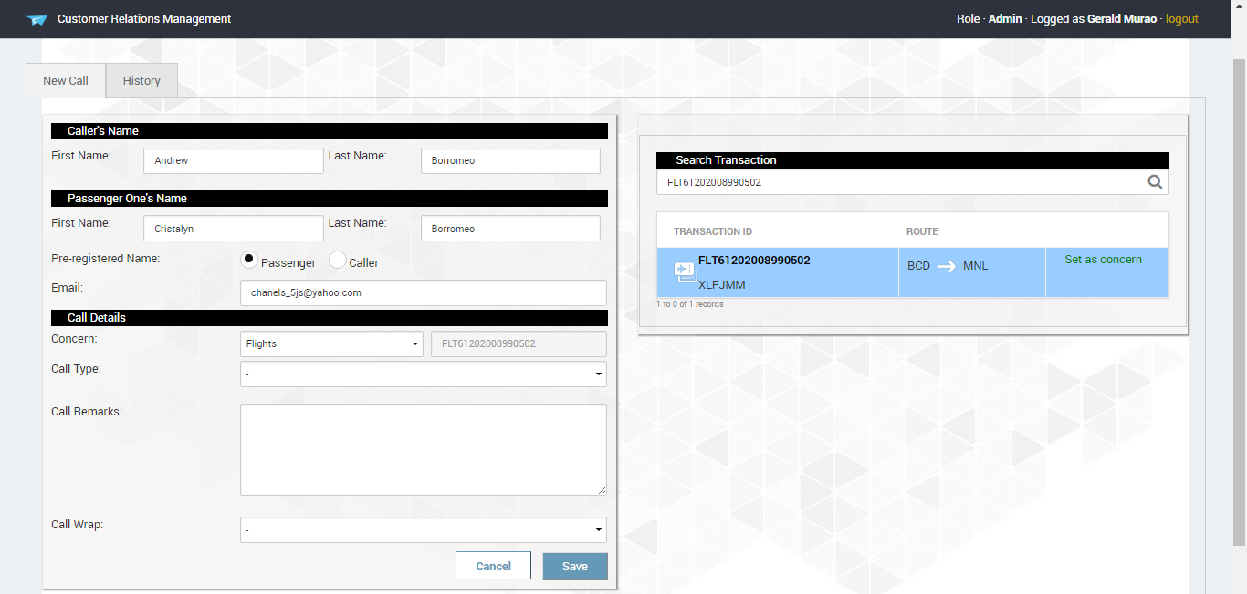
Call Form
New Call Tab
After clicking Select User/Proceed. This is the next web screen to be shown. There are 3 part. 1. caller’s name
2. passenger one
(which is the main passenger booked in our site.)
3. Call Details

Slide 11
Call Form
1. Caller’s Name
This is autofill through the selected name in the call table.
Note:
If the caller is not in the call table you could also retype the callers name.

Slide 12
Call Form
2. Passenger One’s Name
This is also autofill through the selected name in the call table. This Name is the main passenger on the transaction selected on the user table.
Note:
If the selected user has the same name on the main passenger, passenger name will be the caller’s name. This may also happen if the user is register/ pre-register to our site.

Slide 13
Call Form
3. Caller’s details
Concern – This is a drop down box that allow CES to choose what are the main concern of the caller.(eg. Flights, Hotels, Experience Packages, Guides, and Others)
Beside the Concern drop down box is Transaction Id, It is automatically filled out if the CES search on the Call table is Transaction Id or Code Locator. If not, They can search on the Search transaction located at the right part of the Call Form and click the link set as concern.

Slide 14
Call Form
Note:
The transaction Id on the search transaction is clickable, when it is click, there will be a pop up to show the details of the selected transaction. Also the Blue background indicate that the transaction id is the selected transaction.
Also, this Search transaction will appear if there is a Concern selected on the form

Slide 15
Call Form
Call Type
This is a drop down box that allow CES to choose on what the caller want to know on their booking or what they want from their booking. These are categorized in General Inquiry, Booking\Changes, Confirmation refunds, Website\Technical Problem, Payment concerns, and others.

Slide 16
Call Form
Call Remarks
This is a free text field in order for the CES to state the important information during the call session with the customer

Slide 17
Call Form
Call Wrap
This is a drop down box that allow CES to choose on how the call is being ended such as resolved, Changes made, Line cut – hung up – wcb, for agent follow up call, ghost call, others, and pending.

Slide 18
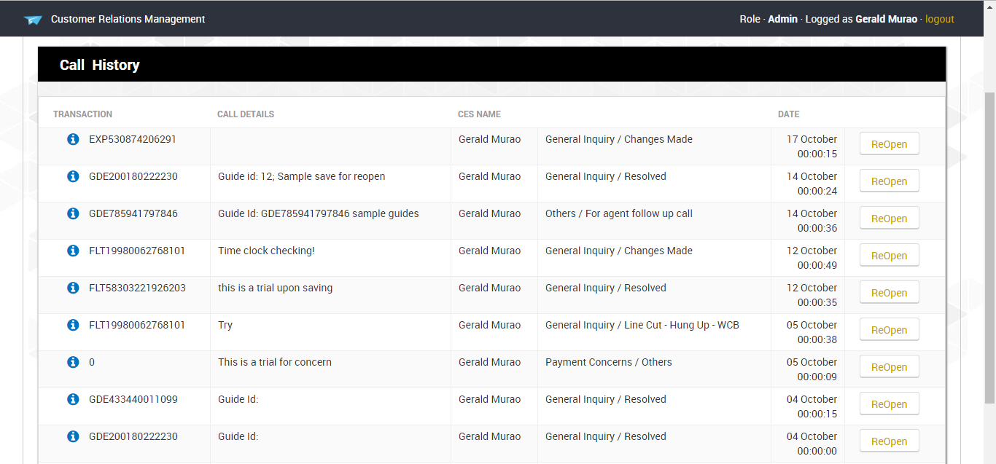
Call Form
Call History tab
This tab allows the CES to view the call log under the current email.
ReOpen
This button allow CES to easily re open the call and create a new call log with the same transaction.

Slide 19
Call Form
Call History tab
This tab allows the CES to view the call log under the current email.
ReOpen
This button allow CES to easily re open the call and create a new call log with the same transaction.

